Slide 1
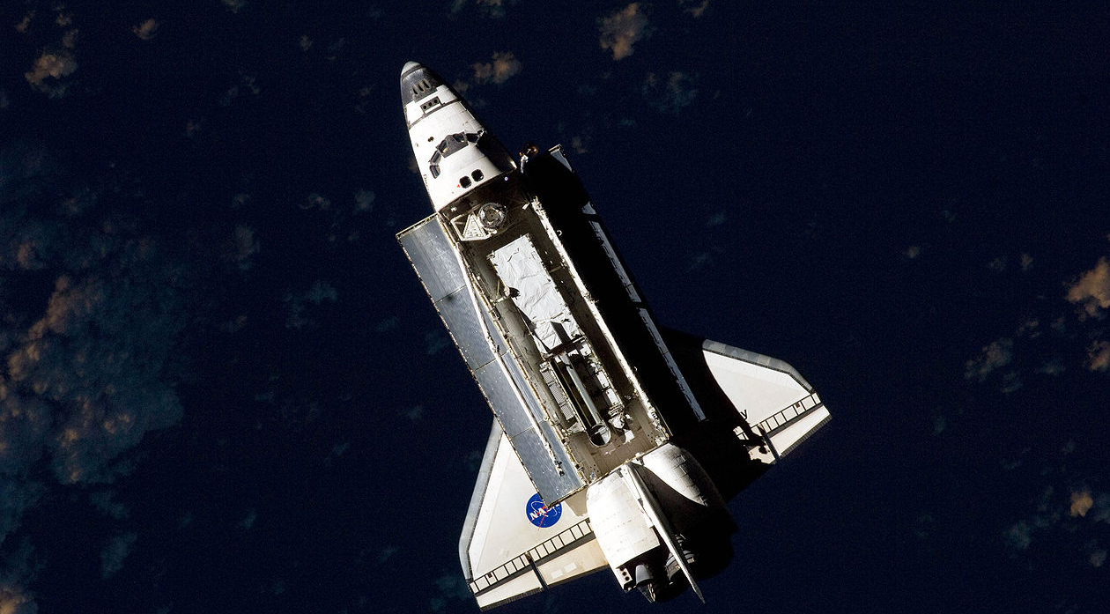
A Tale of Two Shuttles:
NASA Lessons in Team Performance
STS – 107 - 2003
STS – 119 - 2009

Slide 2

4 Dimensions of Team Performance

Slide 3
4 Dimensions of Team Performance
Appreciation
“grows” people
Naturally appreciate
People, Learning, Growth,
“Cultivating”

Slide 4
4 Dimensions of Team Performance
Appreciation
“grows” people
Naturally appreciate
People, Learning, Growth,
“Cultivating”
Naturally relate, so people
feel that they belong,
“Including”
Respect & Inclusion

Slide 5
4 Dimensions of Team Performance
Appreciation
“grows” people
Vision of Possibilities
Naturally appreciate
People, Learning, Growth,
“Cultivating”
Naturally generate Ideas,
“Visioning”
Naturally relate, so people
feel that they belong,
“Including”
Respect & Inclusion

Slide 6
4 Dimensions of Team Performance
Appreciation
“grows” people
Vision of Possibilities
Naturally appreciate
People, Learning, Growth,
“Cultivating”
Naturally generate Ideas,
“Visioning”
Naturally relate, so people
feel that they belong,
“Including”
Naturally manage people and processes, “Directors”
Governance & Responsibility
Respect & Inclusion

Slide 7
4 Dimensions of Team Performance
Appreciation
“grows” people
Vision of Possibilities
FUTURE
Naturally appreciate
People, Learning, Growth,
“Cultivating”
Naturally generate Ideas,
“Visioning”
PEOPLE
MISSION
Naturally relate, so people
feel that they belong,
“Including”
Naturally manage people and processes, “Directors”
Governance & Responsibility
Respect & Inclusion
PRESENT

